Slide 1
WELCOME to my presentation
My name’s Mohammed akbar hossen Department of CSE at Feni university student ID:223031005

Slide 2
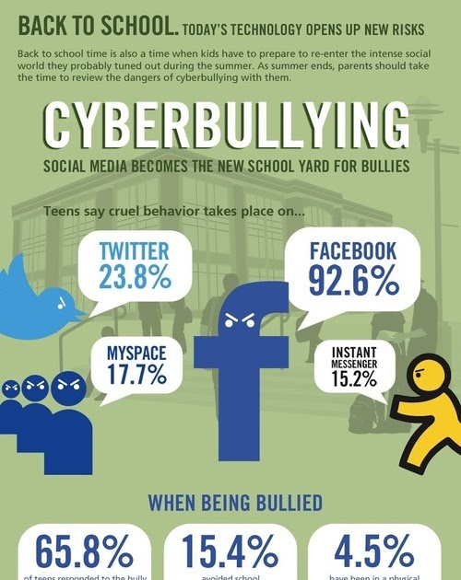
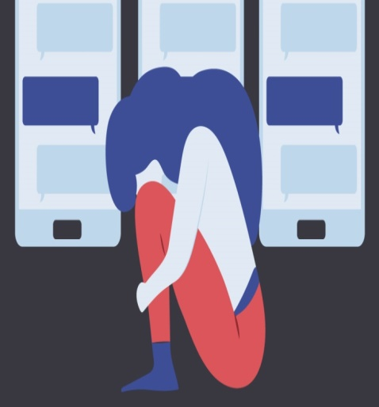
What cyberbullying is?
Cyberbullying or cyberharassment is a form of bullying or harassment using electronic means. Cyberbullying and cyberharassment are also known as online bullying.

Slide 3



Where can cyberbullying take place?
 | Facebook Instragram Twitter Myspace Any kind of online games

Slide 4
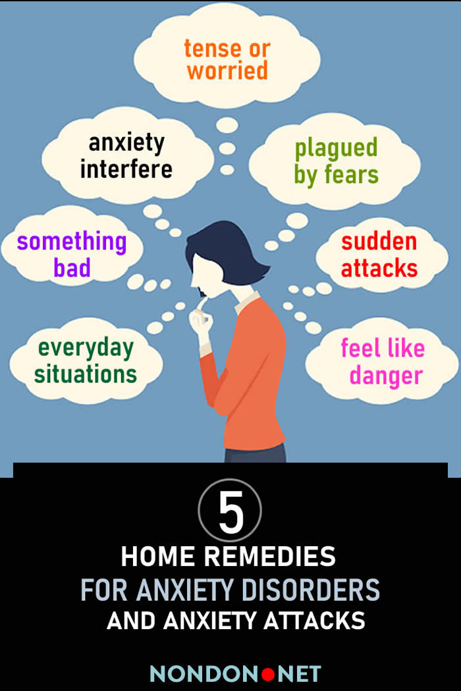
Effect of cyberbullying
 | Some major effects of cyberbullying that can occur often are Anxiety Depression Loneliness Unhappiness Poor sleep
 | In really bad cases some are lead to killing themselves because they feel worthless when tell them they are

Slide 5
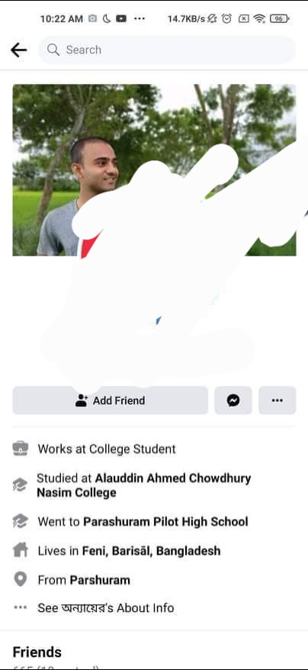
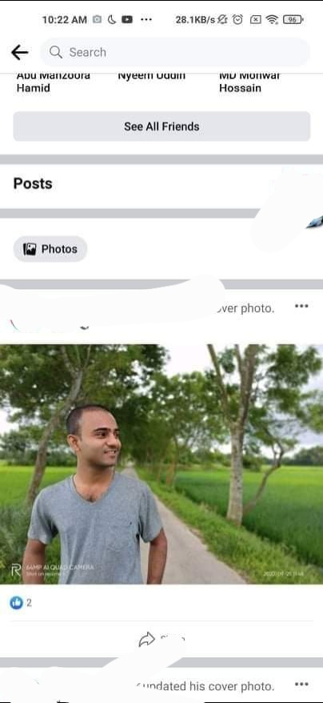
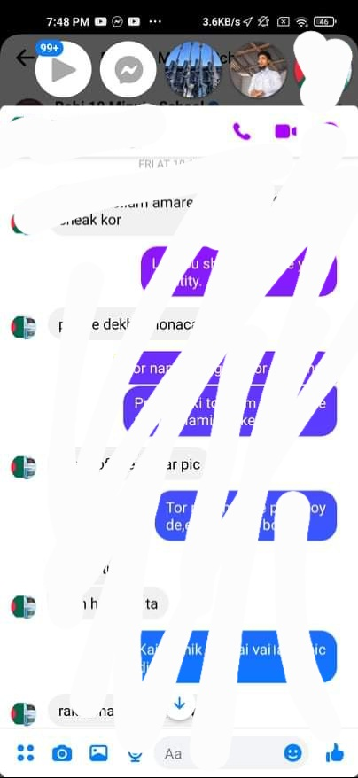
I witnessed and I had been a victim for once

Slide 6

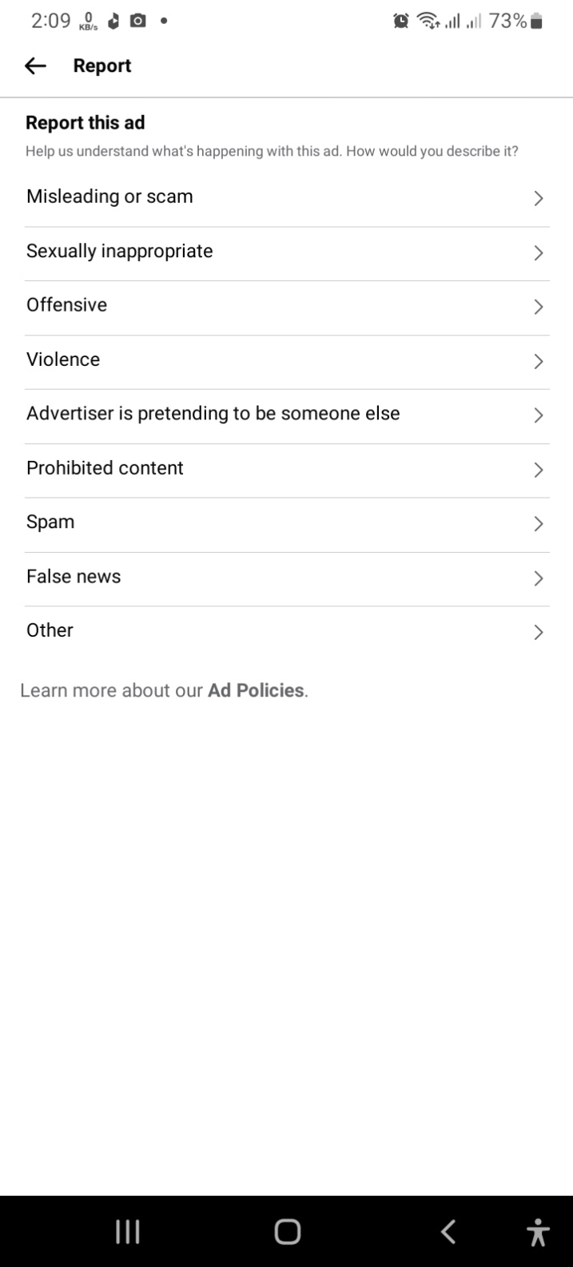
How to report

Slide 7
THANK YOU SO MUCH

